Slide 1
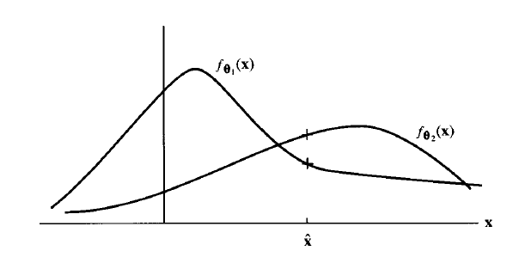







Chapter 6 Maximum Likelihood Estimation

Slide 2
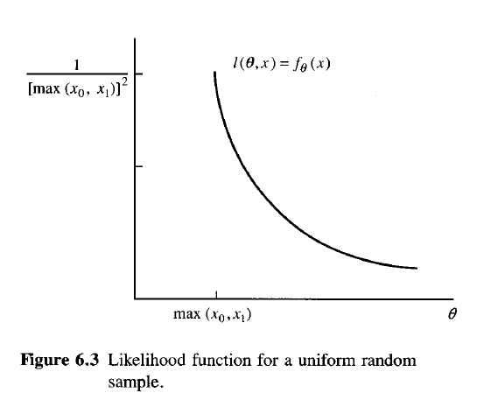







Example: Uniform
Notes:
Finished here 9/27/18

Slide 3





Example: Gaussian
unbiased
biased

Slide 4





MLE for Random Parameters (MAP)

Slide 5








Example: MAP

Slide 6





MLE and Sufficiency

Slide 7








Example: Bernoulli
unbiased

Slide 8






MLE for Functions of θ

Slide 9









Example: Poisson

Slide 10




Example: Gaussian
dx

Slide 11






Estimation Performance
Biased estimators can (and sometimes do) have lower MSE than unbiased ones

Slide 12


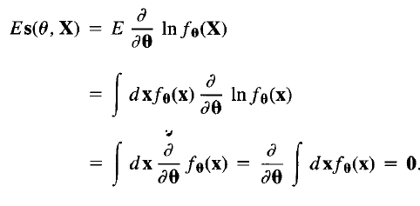
The Cramer-Rao Bound

Slide 13




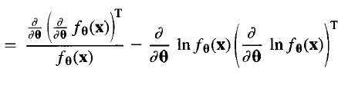



CRB, cont’d
0

Slide 14





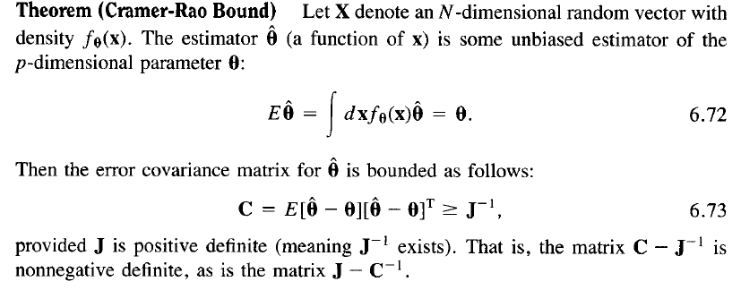
CRB, cont’d

Slide 15







CRB, cont’d

Slide 16












Efficiency

Slide 17

Finding Efficient Estimators
Previous approach to finding MVUB estimators:
Find the sufficient statistic t(x)
Find its mean
If possible, linearly scale t(x) to make it unbiased.
New approach to finding efficient (and possibly MVUB) estimators:
Find the score function.
Check for the form
Determine the efficient estimator from 2.

Slide 18









Example: CRB

Slide 19








CRB for Functions of θ

Slide 20










Numerical Maximum Likelihood

Slide 21





CRB and Nuisance Parameters

Slide 22










MLE for Multivariate Normal Model

Slide 23










CRB for M-ary Normal Model

Slide 24













The Linear Statistical Model

Slide 25





Mode Identification (LSM)

Slide 26




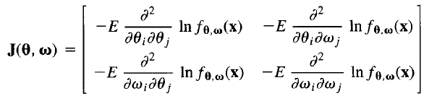

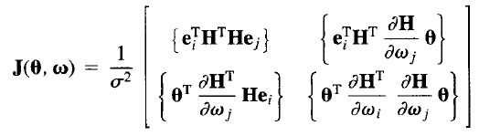

Mode Identification (LSM)
M=1

Slide 27





MLE for Sinusoidal Model

Slide 28









MLE for Sinusoidal Model, cont’d

Slide 29











MLE for Sinusoidal Model, cont’d

Slide 30









MLE for Sinusoidal Model, cont’d

Slide 31









Structured Covariance Matrices

Slide 32










Linearly Structured Covariance Matrices
Example

Slide 33











Linear Structured Covariance Matrices, cont’d

